Slide 1
Let's LEARN statistics
A guide to T-testing

Slide 2
What is t-testing?

Slide 3
Normal Distribution
two parameters:
the population mean and the population standard deviation.
If a variable follows a Normal distribution exactly, its mean, median, and mode will all be equal.

Slide 4
The 68-95-99.7 Rule

Slide 5
Z-Score
measures how many standard deviations an observation is from the population mean.
z_i = (x_i - [population mean of x]) / [standard deviation of x]

Slide 6
T-score
Used when we have a sample of the population
assumes that the population standard deviation is unknown
T = [sample mean] +/- [t multiplier] * [s/sqrt(n)]
s is the sample standard deviation and the t-multiplier changes based on both the confidence level and the sample size n.

Slide 7
Confidence Intervals
Confidence Interval | Alpha
90% | 10%
95% | 5%
99% | 1%

Slide 9
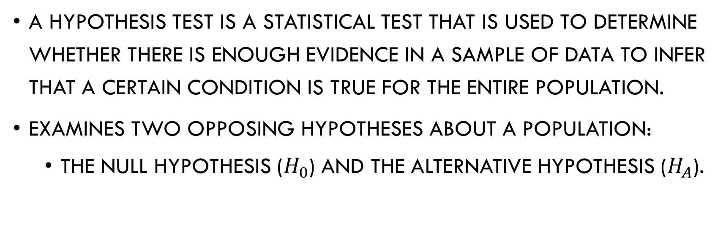
Hypothesis Testing
A hypothesis test is a statistical test that is used to determine whether there is enough evidence in a sample of data to infer that a certain condition is true for the entire population.
examines two opposing hypotheses about a population:
the null hypothesis ($H_{0}$) and the alternative hypothesis ($H_{A}$).

Slide 10
Step 1: Define the Hypothesis
H_0: mean >= Median
H_A: mean < median

Slide 11
Step 2: Specify a level of significance
This is known as setting an alpha
levels are 0.01, 0.05, and 0.10.
The most common level is 0.05.

Slide 12
Step 3: Calculate point estimate
point estimate will typically be your sample mean

Slide 13
Step 4: Calculate test statistic
z = (x-bar - mu) / (sigma/sqrt(n))

Slide 14
Step 5: Find your p-value
the probability of finding the observed, or more extreme, results when the null hypothesis (H ₀) of a study question is true

Slide 15
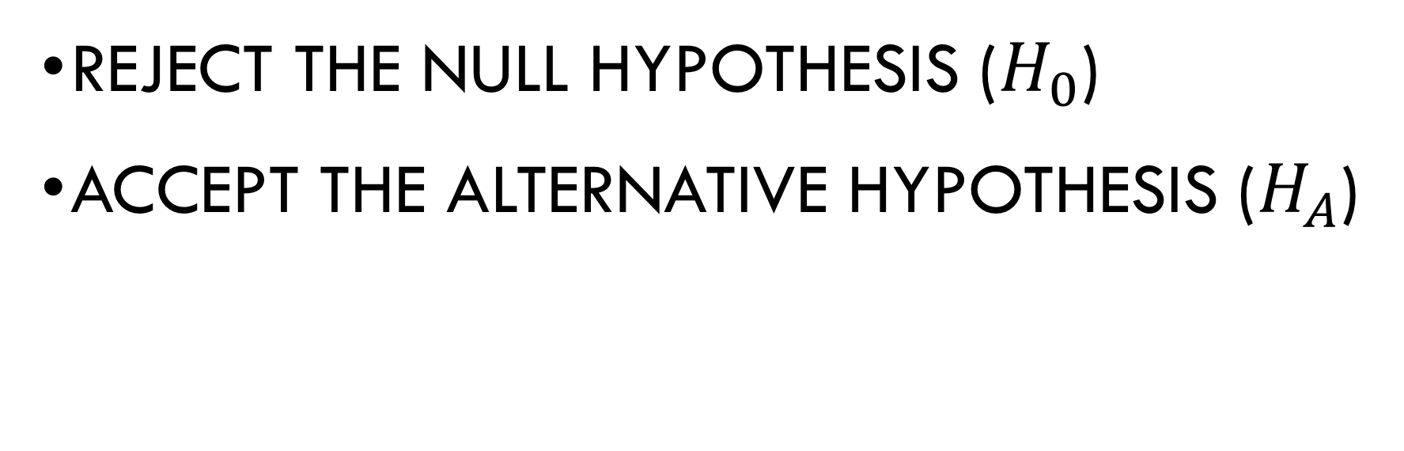
If p value < pre-determined alpha
reject the null hypothesis ($H_{0}$)
accept the alternative hypothesis ($H_{A}$)

Slide 16
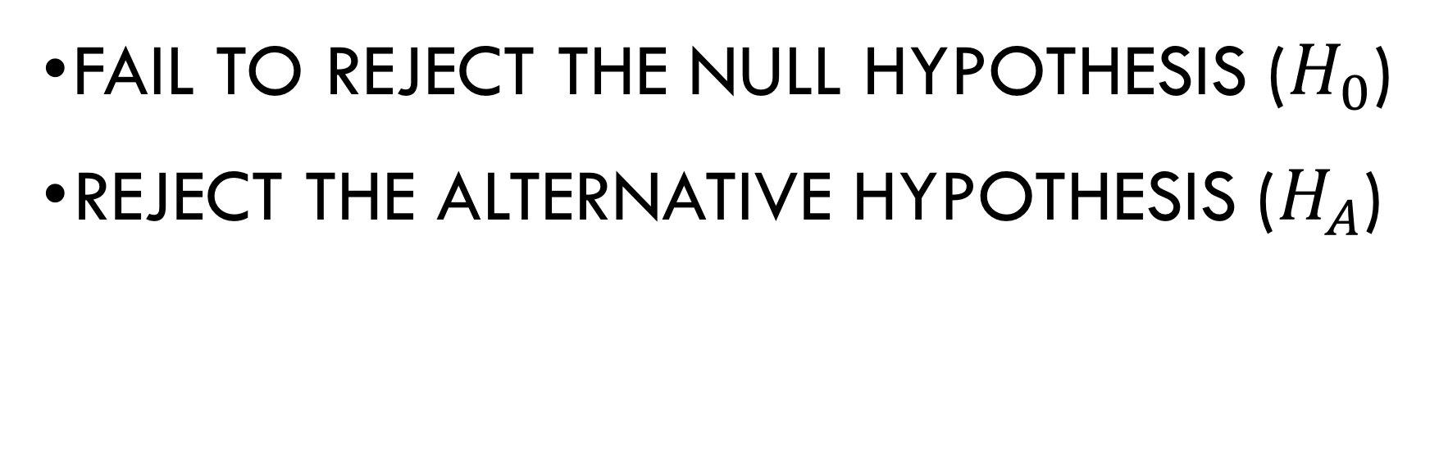
If p value > pre-determined alpha
FAIL TO REJECT the null hypothesis ($H_{0}$)
reject the alternative hypothesis ($H_{A}$)

